Slide 1
SKIN CANCER & SUN SAFETY

Slide 2
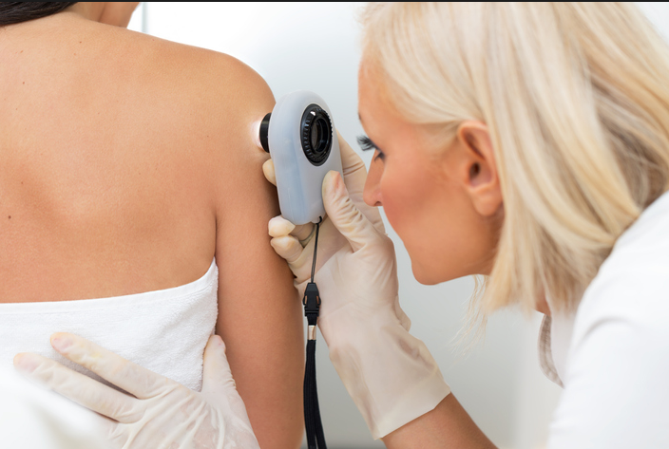
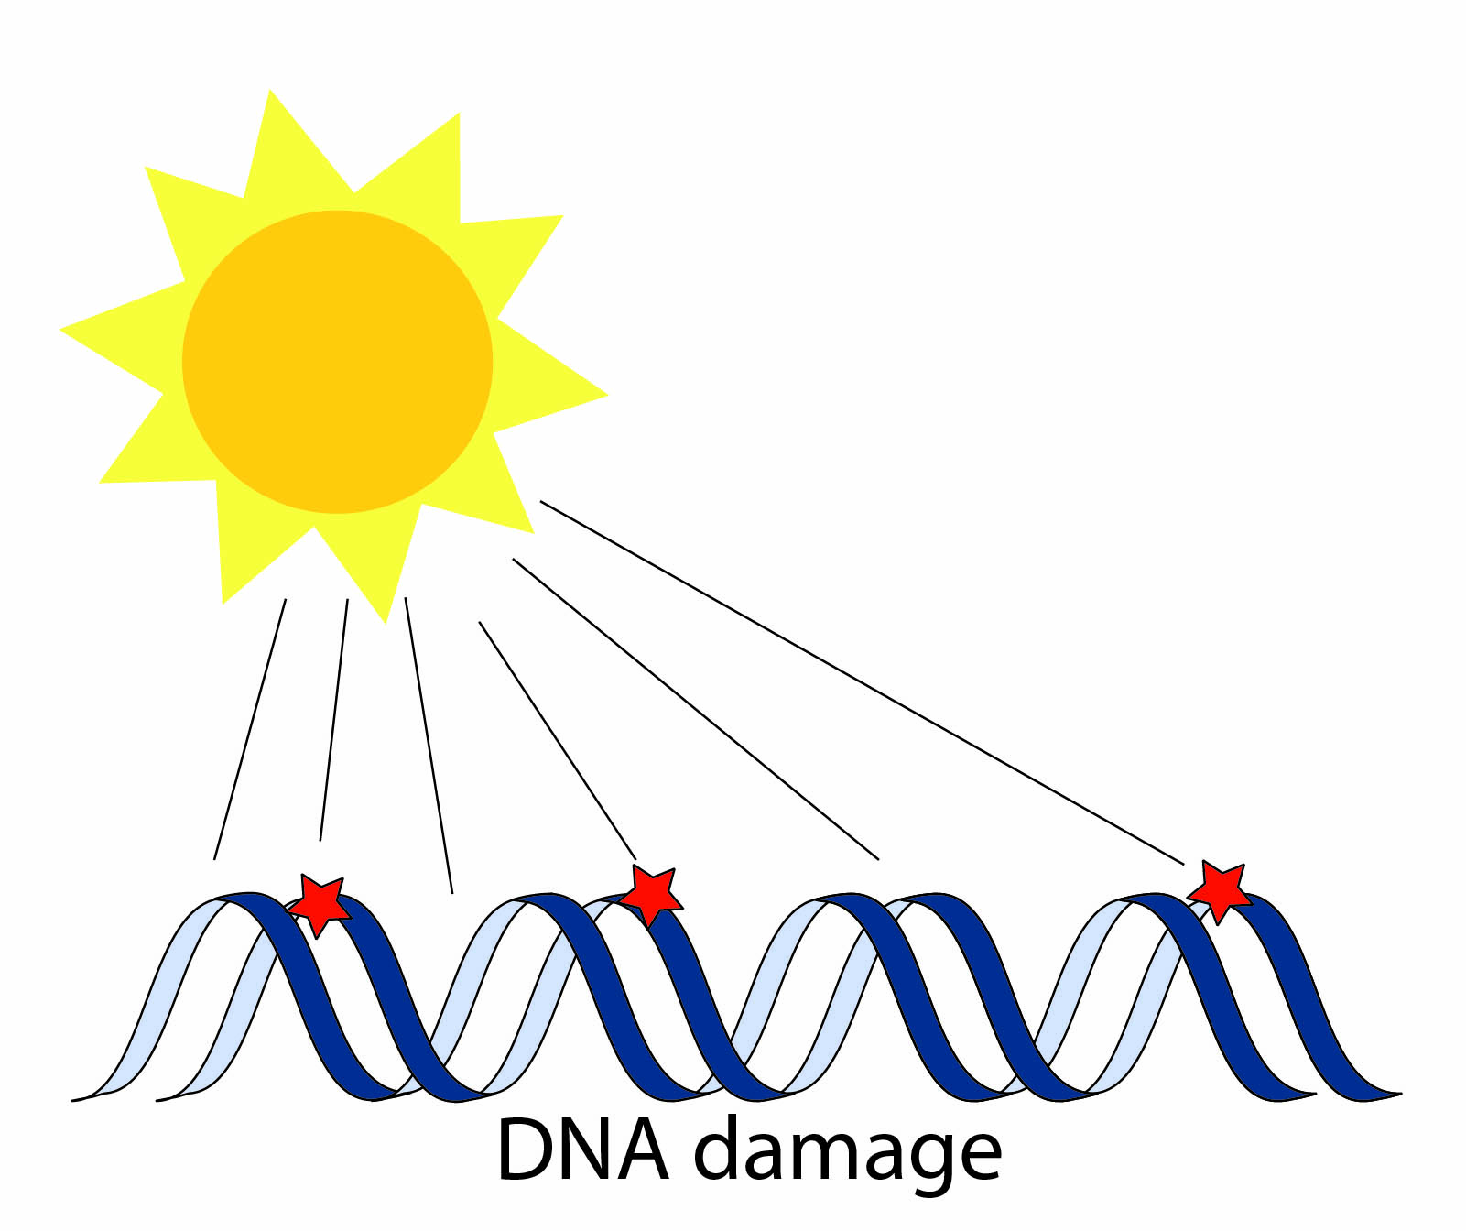
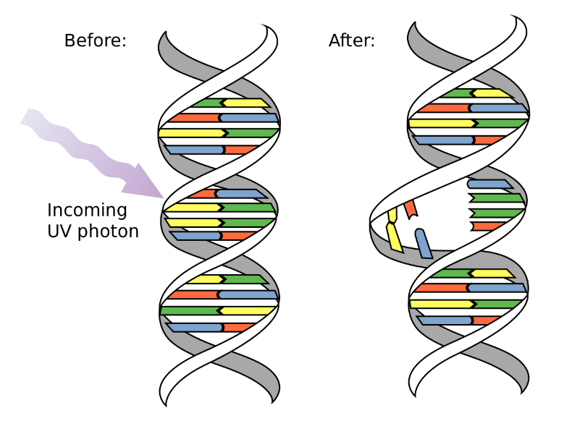
What is skin cancer?
- Skin cancer is the abnormal growth of skin cells
- DNA damage to the skin (often from UV radiation) causes mutations that cause skin cells to multiple abnormally and form tumors
- Skin cancer often forms in areas that are exposed to the sun, but can develop anywhere
- 1 in 5 Americans will develop skin cancer in their lifetime
If caught early, 90-95% of skin cancers are curable

Slide 3
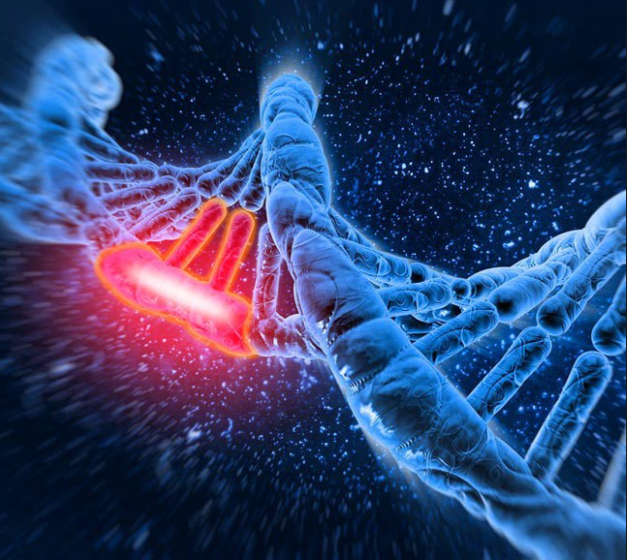
Mutations and cancer
Types of mutations:
Inherited mutation (aka germline or hereditary): present in the egg or sperm that formed that child, can be passed down through generations, only responsible for a small fraction of cancers
Somatic mutations (aka acquired): not present in the egg or sperm and acquired later in life; it starts in one cell and is passed on to new cells made from that cell; these mutations are common and responsible for most cancers
Activating mutation (aka gain-of-function): usually a dominant mutation, gives increased or new activity to a protein; implicated in causing cancer
Loss-of function: usually recessive, causes a protein product to have no or reduced function; loss of a protective function may cause cancer

Slide 4
Layers of the skin
-Most damage occurs in the epidermis, the outer part of the skin
-The layers of the epidermis are as follows (superficial to deep)
-Stratum corneum (outermost layer with increased keratinization that prevents infection and dehydration)
-Stratum lucidum (thin layer only found in palms/soles/digits)
-Stratum granulosum (cells in this layer secrete keratohyaline granules, which have proteins that bind keratin filaments; also prevents dehydration)
-Stratum spinosum (spiny appearance due to desmosomes joining adjacent cells)
-Stratum basale (contains basal cells: precursors to keratinocytes)
-Below the epidermis is the dermis, which has nerve endings, sweat glands, hair follicles, sebaceous glands, blood vessels, and collagen (gives the skin flexibility and strength)

Slide 5
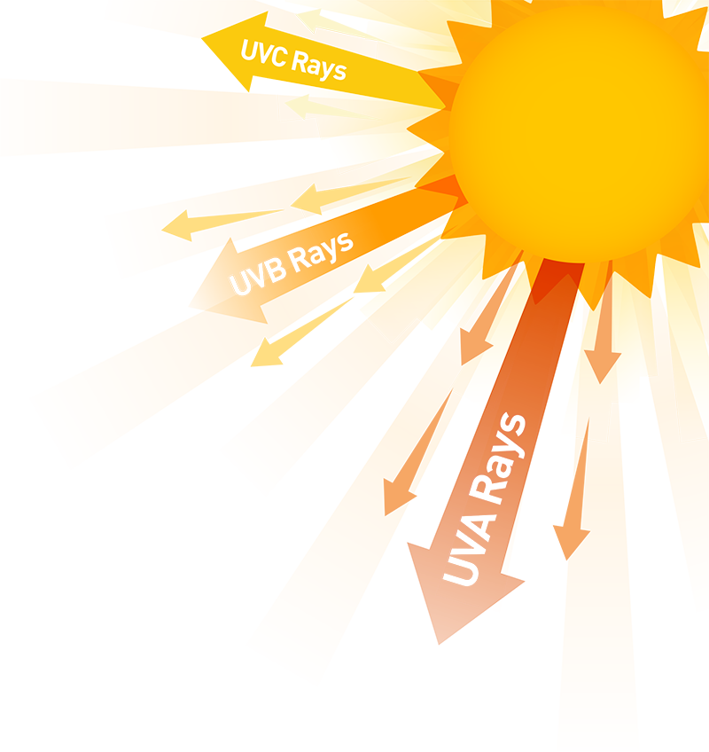
What causes skin cancer?
UV radiation is a major cause of skin cancers
Some genetic diseases make families more susceptible to developing skin cancer
For example, patients with Xeroderma Pigmentosa are much more likely to develop skin cancer than the general population
Xeroderma Pigmentosa (XP) is disease in which the nucleotide excision repair (NER) enzymes are mutated
Therefore, UV-induced mutations to a patient’s DNA are not able to be repaired properly

Slide 6
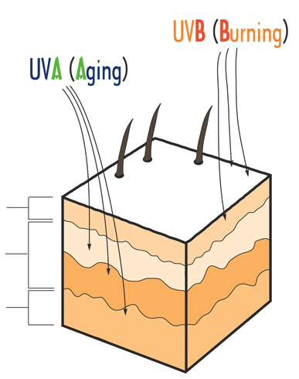
UVA and UVB Radiation
- 90% of skin cancer is caused by ultraviolet radiation
- Two important types of UV radiation are UVA and UVB radiation
UVB has a wavelength of 290-320 nm
UVA has a wavelength of 320-400 nm
- UVA causes tanning, aging & skin cancer
- UVB causes burning & skin cancer
- Tanning beds emit 12 times more UVA than the sun
- UV exposure increases by 4% for every 1,000 foot elevation gain above sea level
EPIDERMIS
DERMIS
SUBCUTIS

Slide 7
Types of skin cancer
There are 3 common types of skin cancer:
Basal Cell Carcinoma
Squamous Cell Carcinoma
Melanoma

Slide 8
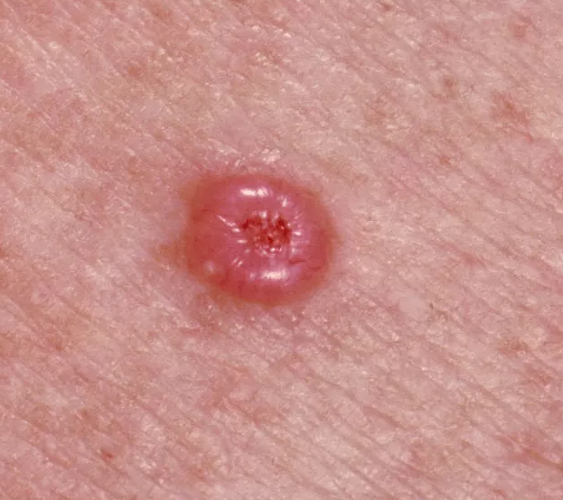
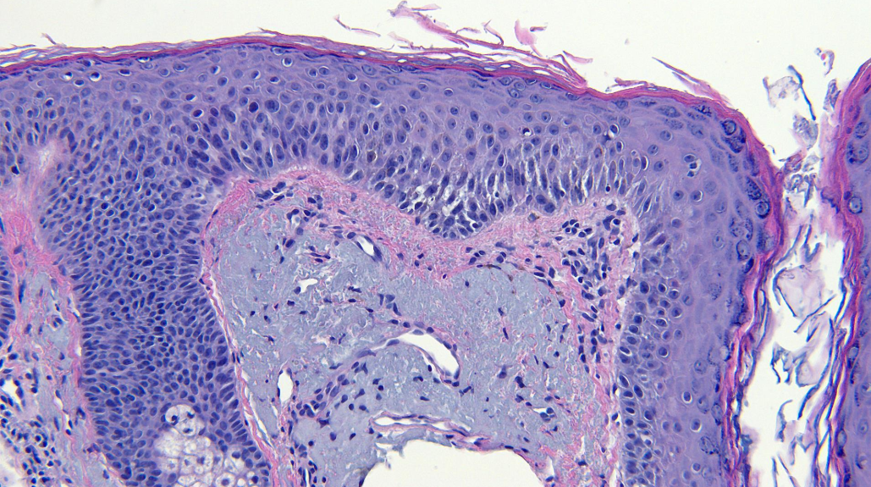
Basal cell carcinoma (BCC)
- Cancer of the basal cells of the epidermis (the type of cell that produces new skin cells)
- It is estimated that 4 million BCCs are diagnosed in the US each year! (BCC is very common)
- Risk factors: fair skin, geographical regions closer to the equator, older age, incidence in men>women
- Gross appearance: waxy, pearly nodule with central ulceration
- Histologic Appearance (how it would look under a microscope if a sample was taken): Peripheral palisading of the nuclei

Slide 9
Basal cell carcinoma (BCC)
Pathogenesis: UV damage is causative; genetics have an influence as well:
- Genes implicated: PTCH1 is a tumor-suppressor gene that is located on chromosome 9
- This pathway is important with regards to treatment of BCC
Treatment:
- Electrodessication and curettage or surgical excision (wide local excision or Mohs surgery)
- For advanced cases, vismodegib oral daily dose, which is a small molecule inhibitor of SMO
- Metastasis is rare; morbidity usually is due to local destruction of surrounding tissues
- Overall, outcomes are excellent for BCC

Slide 10
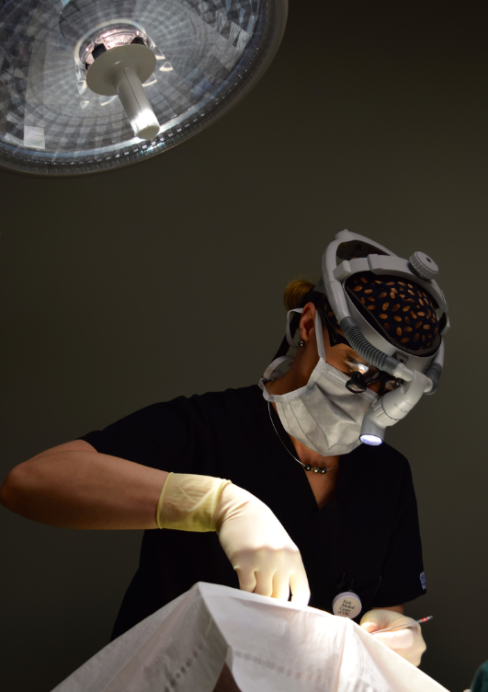
Mohs surgery
- Mohs surgery is a technique used to treat skin cancer
- Thin layers of cancer tissue are progressively removed and examined under a microscope until all of the cancerous tissue is removed
- This technique allows examination of the margins in real time to ensure that all of the cancer is removed
- It also allows for the least amount of tissue to be removed so that the scar is minimized

Slide 11
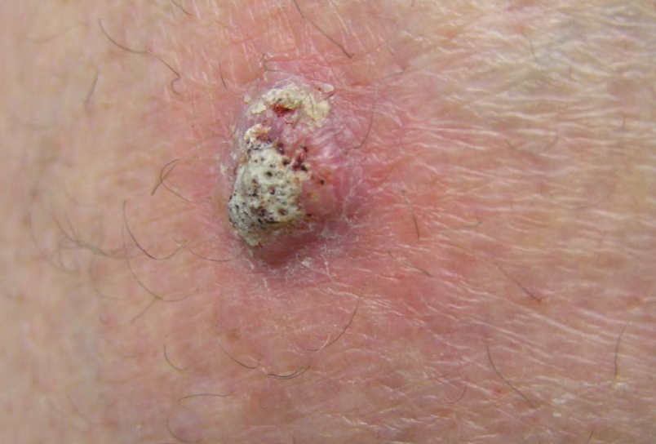
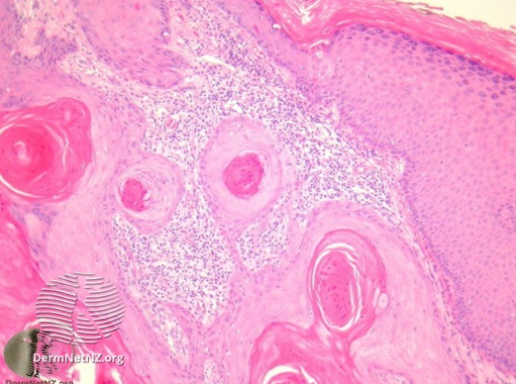
Cutaneous squamous cell carcinoma (SCC)
- Cancer of the squamous cells, which are the flat cells in the upper epidermis that are constantly turning over
- It is estimated that over a million SCCs are diagnosed in the US each year, with about 5% of SCCs metastasizing (spreading to other parts of the body)
- Risk factors: Sun exposures, older age, incidence in men>women, immunosuppression, chronic inflammation, genetic disorders (XP)/family history
- Gross appearance: Ulceration with scaling
- Histologic Appearance (what it looks like under a microscope): Keratin pearls with nests of squamous cells extending into the dermis

Slide 12
Cutaneous squamous cell carcinoma (SCC)
Pathogenesis:
- UV damage is causative, genetic and epigenetic alterations also play a role
- Some (~50%) of SCCs arise from a precursor lesion called an actinic keratosis (AK)
- Gene mutations implicated: p53 (tumor suppressor gene, role in repairing DNA damage), NOTCH (cell-cell communication)
- Only 5% of SCCs metastasize; common locations for metastases are lymph nodes, liver, lungs, and bone
Treatment:
- Electrodessication and curettage or surgical excision (wide local excision or Mohs surgery)
- For advanced cases, chemotherapy may be used. 5-fluorouracil is used along with surgical excision (called an adjuvant) and EGFR inhibitors are used systemically (Cetuximab)

Slide 13
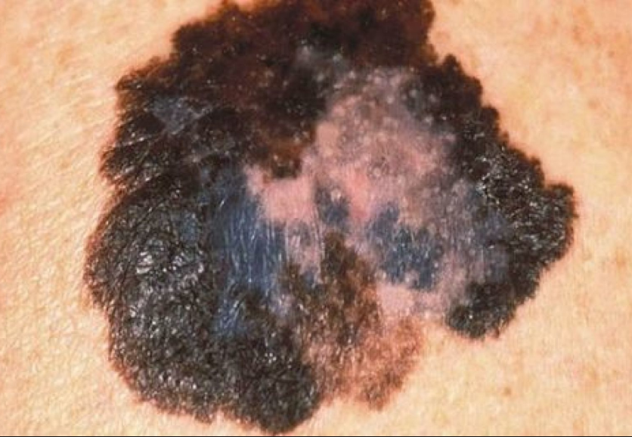
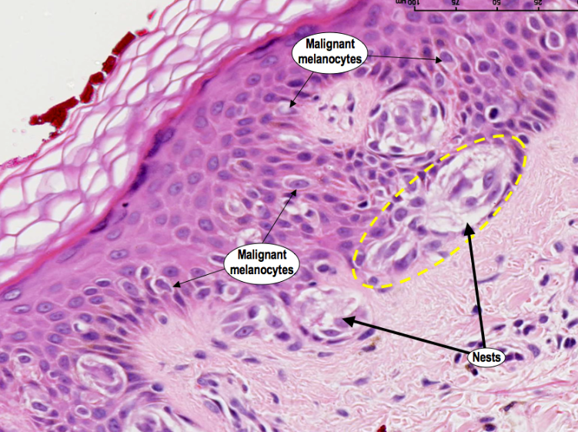
Melanoma
- Melanoma is a cancer of the melanocytes in the skin, which are the cells that have a role in skin pigmentation
- The incidence of melanoma is highest in regions close to the equator, in fair-skinned individuals, and more common in women under 40 and in men over 40; melanoma is the most common skin cancer in 25-29 year olds
- The new cases of melanoma have been rising each year and it is estimated that there will be a 7.7% increase in cases diagnosed in 2019 ---> we need to reverse this trend!
- Risk factors: sun exposure, genetics (ie familial atypical multiple mole melanoma syndrome & dysplastic nevus syndrome)
- Gross appearance: look for ABCDEs (upcoming slides)
- Histologic appearance (how it looks under a microscope): atypical cells, nests of melanocytes

Slide 14
Melanoma
Pathogenesis:
- UV radiation is causative, as are genetic mutations
- BRAF kinase activating mutation (involved with growth/proliferation signaling) can be involved, vemurafenib is an inhibitor of this and is used to treat particular cases of melanoma
- Other genes involved are CDKN2A (cell senescence regulator) and MC1R (pigmentation gene, involved in familial melanoma)
Treatment:
- Depends on the stage; for early lesions, wide local excision +/- sentinel lymph node biopsy; for more advanced tumors immunotherapy and/or chemotherapy is used
- Vemurafenib, newer immunotherapies nivolumab (PD-1) or pembrolizumab (PD-1) are proving to be effective, radiation may also be used for advanced cases
- Melanoma has the lowest survival rate among all skin cancers

Slide 15
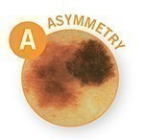
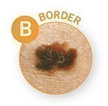
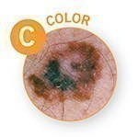
ABCDES OF MELANOMA
A = Asymmetry - One half is unlike the other half
B = Border - An irregular, scalloped or poorly defined border
C = Color - Varied from one area to another; has shades of tan, brown or black, or is sometimes white, red, or blue

Slide 16
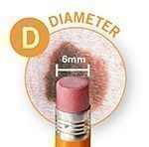
ABCDES OF MELANOMA
D = Diameter - Melanomas are usually greater than 6mm (the size of a pencil eraser) when diagnosed, but they can be smaller
E = Evolving - A mole or skin lesion that looks different from the rest or is changing in size, shape or color
A change in an existing mole is the number one risk factor for a melanoma!

Slide 17
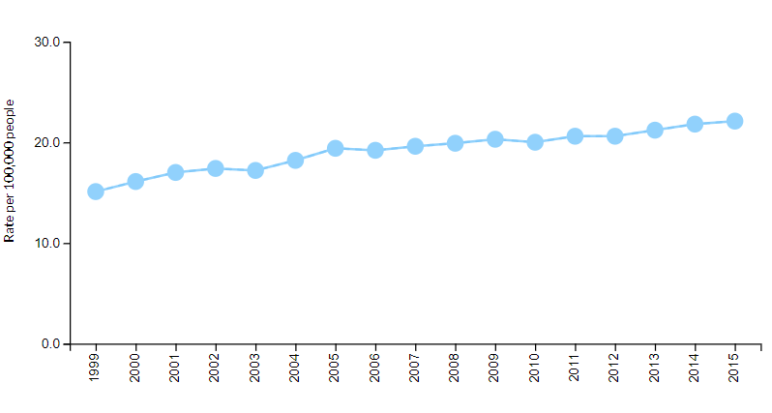
Changes Over Time: Melanomas of the Skin
All Ages, All Races/Ethnicities, Both Sexes
Annual Rates of New Melanoma Cases, 1999-2015
United States
Notes:
- Incidence of melanoma has doubled in the US over the last 20 years in young women.

Slide 18
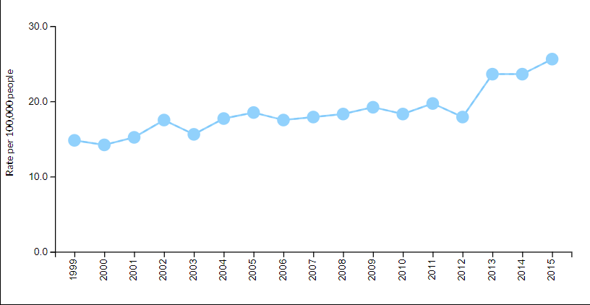
Changes Over Time: Melanomas of the Skin
All Ages, All Races/Ethnicities, Both Sexes
Annual Rates of New Melanoma Cases, 1999-2015
Nebraska

Slide 19
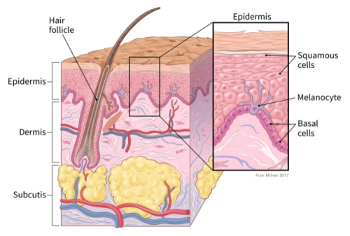
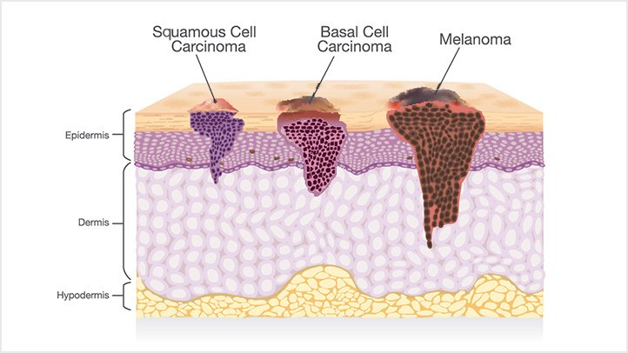
Recap about skin cancer
- Most common: basal cell carcinoma (followed by squamous cell carcinoma)
- In the U.S., 5.4 million basal and squamous cell skin cancers are diagnosed each year
- Melanoma is more dangerous due to greater risk for metastasis
- Melanoma is the second most common form of cancer in females age 15-29
- In 2018, the NIH reported:
- 91,270 people diagnosed with melanoma
- 9,320 died from melanoma
1 American dies from melanoma every hour

Slide 20
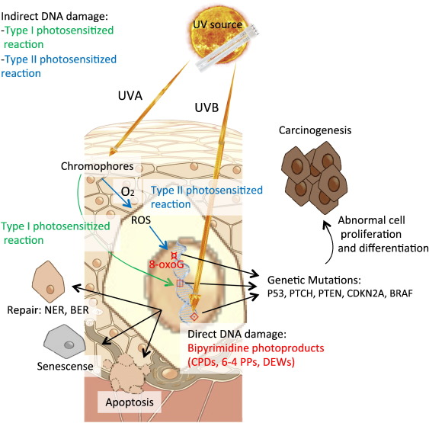
Relationship between sunburns and skin cancer
Sunburns (esp. blistering) increases the lifetime risk of melanoma
Age at time of sunburn matters
- Any sunburn before the age of 13 years = 1.9x more likely to develop melanoma
- Any sunburn between 13-19 years = 1.6x more likely to develop melanoma
- Any sunburn after 19 years = 1.4x more likely to develop melanoma

Slide 21
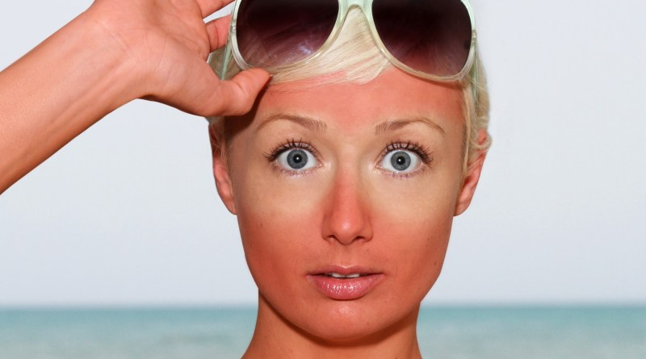
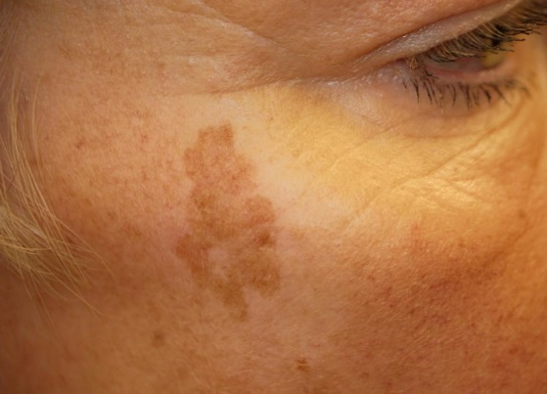
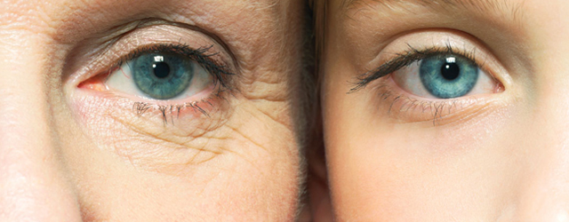
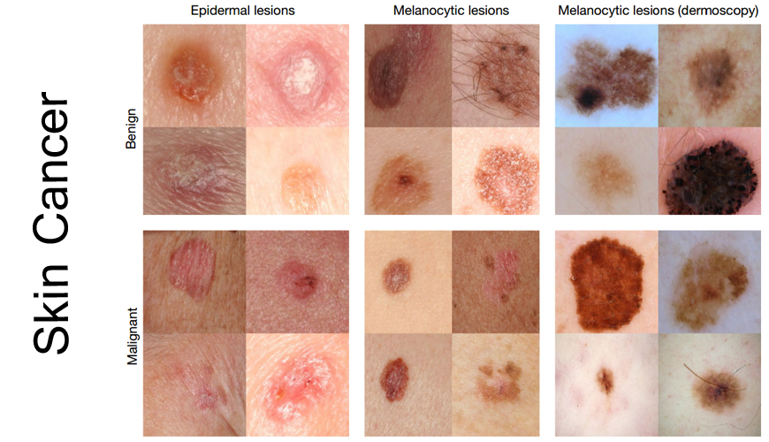
Risks of Sun Exposure
Short-term: Sunburn
Long-term: Photoaging & Skin Cancer
“Liver “spots (age spots)
Premature aging

Slide 22
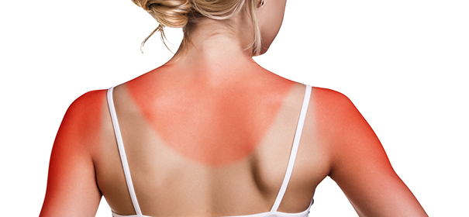
Sunburn
- Keratinocyte damage predominantly results from UVB light →
- Epidermal thickening →
- Inflammatory cytokines are released →
- The skin becomes red and tender in the hours after sun exposure.

Slide 23
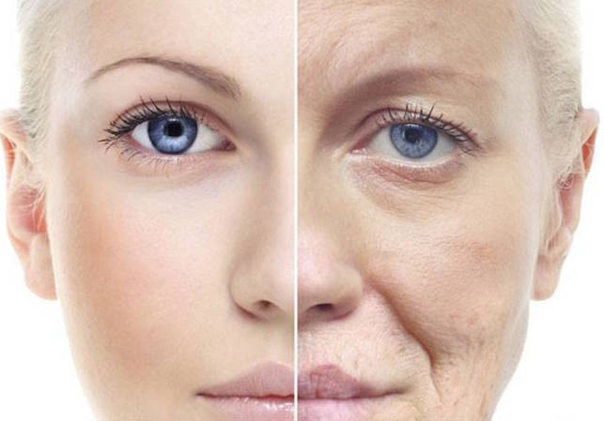
Photo-aging and Skin Cancer
In terms of aging, UVA light is thought to be the biggest offender, due to deeper penetration into the dermis, where collagen is present
- UVA is able to penetrate window glass
- A is for “Aging”
UVB light may also contribute to photoaging
- Higher energy photons cause DNA damage & skin cancer
Notes:
Effect of UVR on photoaging is mediated by ROS
ROS generation results from interactions between UV photons and endogenous photosensitizers (porphyrins, riboflavin, quinines, trans-urocanic acid) that become excited and subsequently react with O₂ to produce ROS including free radicals such as superoxide anion radical (O₂-) and hydroxyl radical (OH-) in addition to nonradicals such as singlet oxygen (O₂) and hydrogen peroxide (H₂O₂)
activity of MMPs increases with exposure to UVB light, increasing the destruction of existing collagen and also decreasing the production of de novo collagen

Slide 24
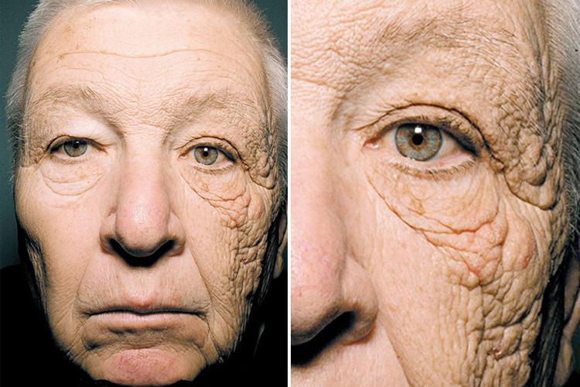
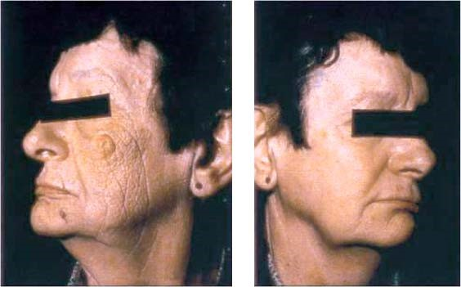
UVA even penetrates glass!

Slide 25
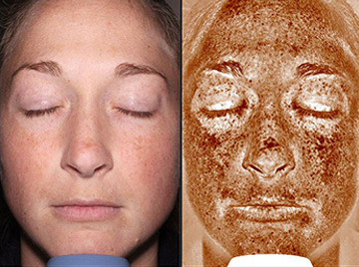

Slide 26
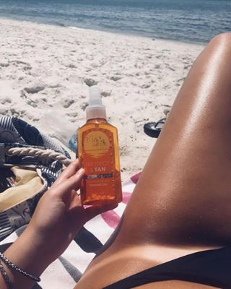
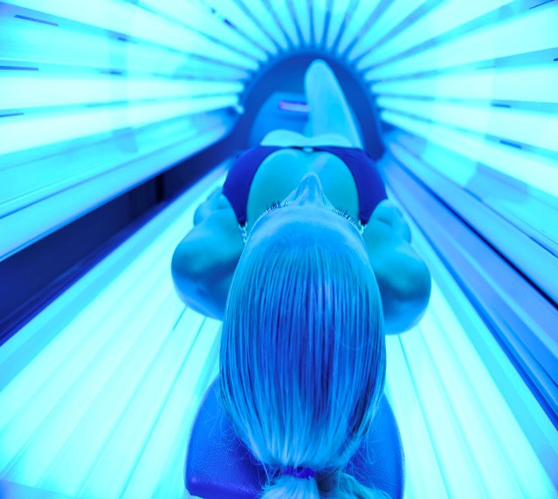
Tanning
- The process whereby skin color is darkened by exposure to ultraviolet (UV) radiation from the sun or from artificial sources, such as a tanning bed.
- >419,000 cases of skin cancer in the U.S. each year are linked to indoor tanning.
- More people develop skin cancer because of indoor tanning than develop lung cancer because of smoking!
Notes:
UV photons react with endogenous photosensitizers (porphyrins, riboflavin, quinines, trans-urocanic acid) → become excited and subsequently react with O₂ to produce ROS including free radicals such as superoxide anion radical (O₂-) and hydroxyl radical (OH-) in addition to nonradicals such as singlet oxygen (O₂) and hydrogen peroxide (H₂O₂) → the singlet oxygen anion induces guanine moiety oxidation followed by structural rearrangement and 8-oxo-7,8-dihydroguanine (8-oxo-G) and 8-oxo-7,8-dihydro-2’-deoxyguanosine (8-oxo-dG) formation, which is the biochemical marker of UV-A-induced DNA damage

Slide 27
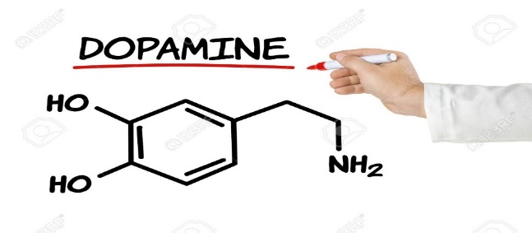
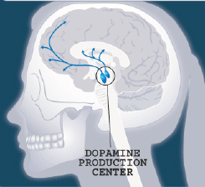
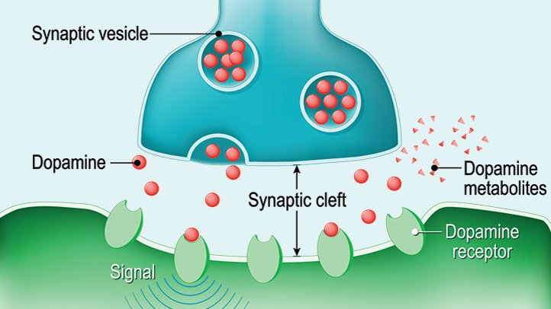
Why Do People Tan?
Euphoria: an overwhelming feeling of happiness
Either normal reaction or a result of substance abuse
Dopamine is the primary neurotransmitter responsible for euphoria.
Media has portrayed tanning in a positive light.
Adolescents, especially females, may view sunbathing or “tanning” as a positive activity…
But tanning is actually the skin’s response to photodamage!
Melanocytes transfer melanin to keratinocytes in an effort to “shield” the DNA from harmful radiation.

Slide 28
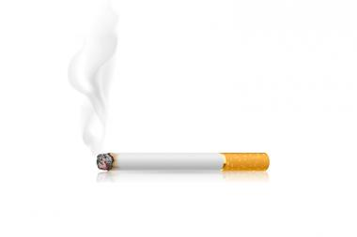
Tanning Addiction
Why is tanning addictive?
Physiological mechanism similar to substance use and abuse
Induction of endogenous opioids

Slide 29
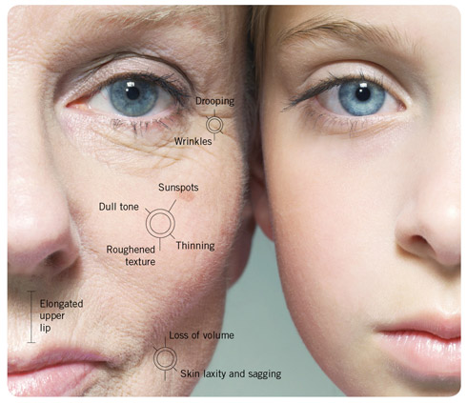
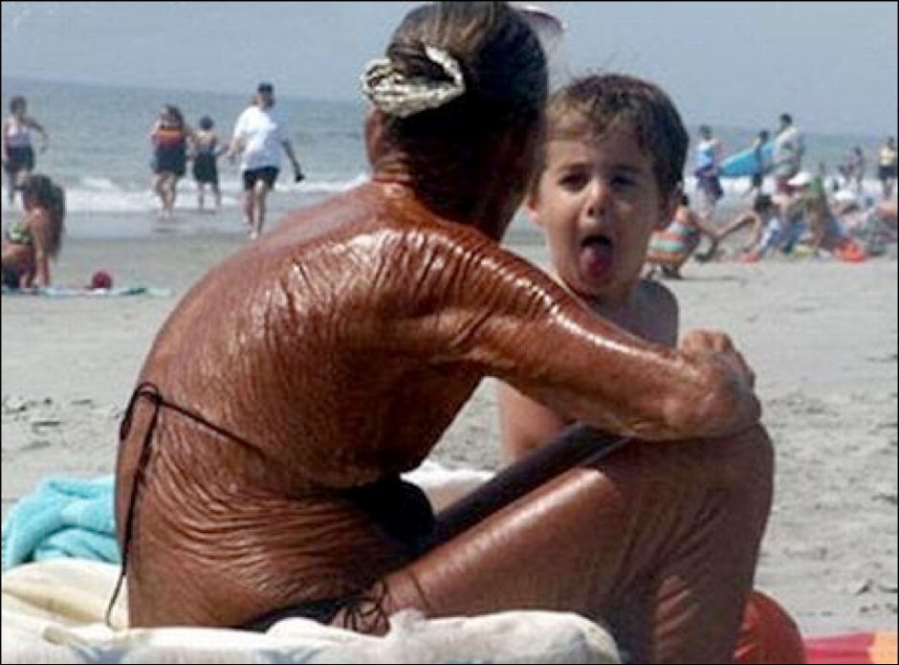
Did you know?
“The Bed is Dead”
- Tanning indoors before age 35 can increase risk of melanoma by 59% (risk increases with each use).
- Tanning effects are generally irreversible.
There’s No Such Thing as a Healthy Tan

Slide 30
Percentage of U.S. High School Students Who Reported Indoor Tanning in the Past Year

Slide 31
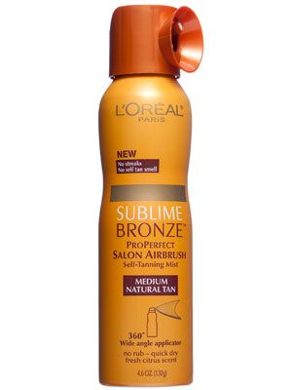
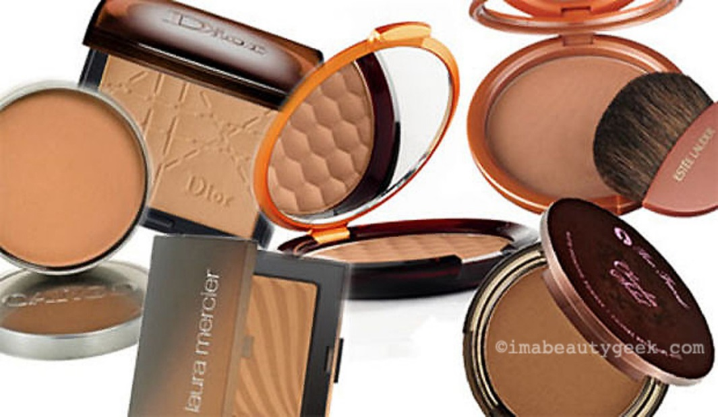
Self Tanning
- Accept the natural color of your skin.
- If you must tan, you can use chemical products which can produce a tanning result without exposure to ultraviolet radiation, such as:
Spray tan
Bronzing powders
*this is the only safe way to obtain a tanned look*

Slide 32
Assess Your Risk for Skin Cancer

Slide 33
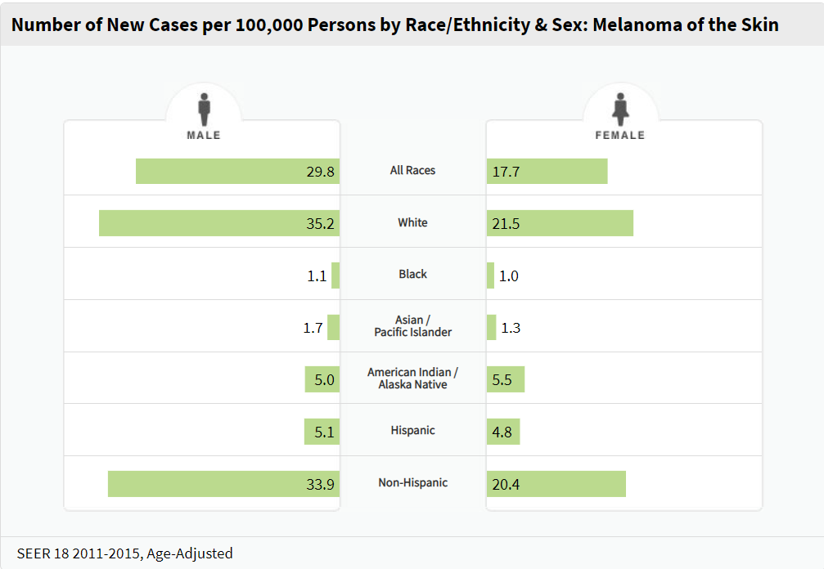

Slide 34
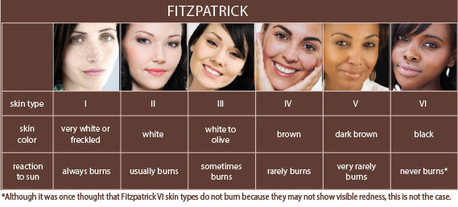
Skin Type Scale
People with fair skin, blonde/red hair, and blue eyes are at the highest risk for skin cancer.

Slide 35
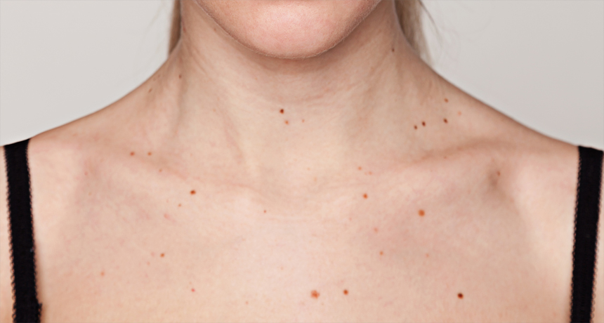
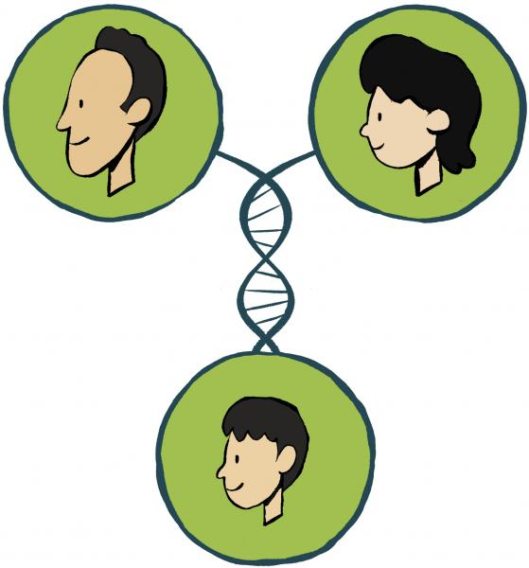
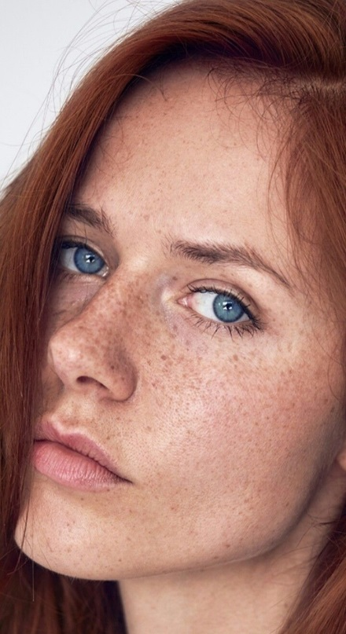
Risk Factors for Skin Cancer
- People with certain characteristics are at greater risk:
People with fair skin, freckles, and light eyes
Blonde or red hair
>50 moles
A family history of skin cancer
A personal history of skin cancer
Even 3-6 blistering burns under age 18 increase your risk for skin cancer → start prevention early!
…but anyone can get skin cancer!

Slide 36
How can I protect myself?

Slide 37
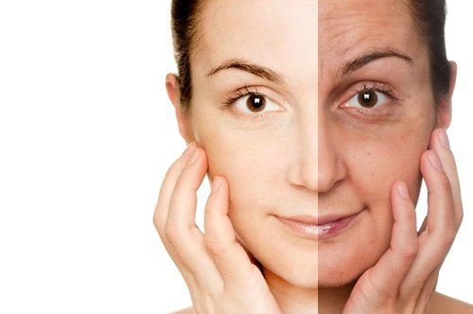
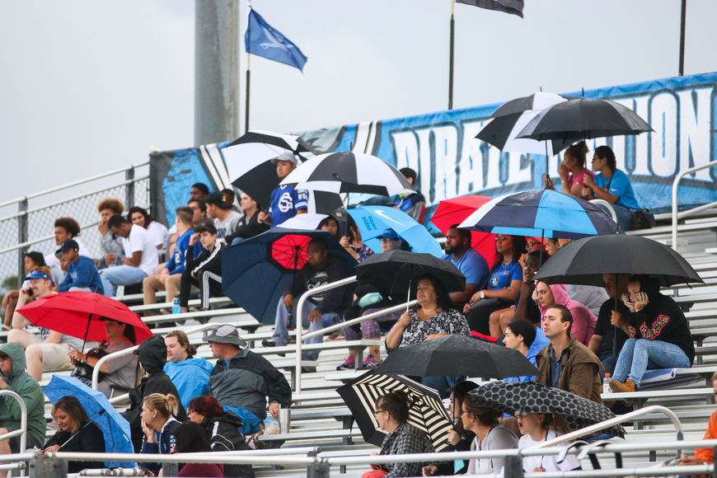
Monitor UV Index and Seek Shade
- Check the UV Index
- Try to avoid sun exposure at peak UV hours of 10:00 am to 4:00 pm
- Download the EPA UV Index App on your smart phone to monitor UV Index for next 4 days (daily reports also on Apple weather app)
- Even on a cloudy day, 80% of UV radiation penetrates clouds!
- Seek shade or go inside when you can
- Use portable shade covers (e.g. umbrella)
- Some mediations like antibiotics increase your risk of sun burn-be sure
to ask your doctor about the effects of any mediations you may be taking

Slide 38
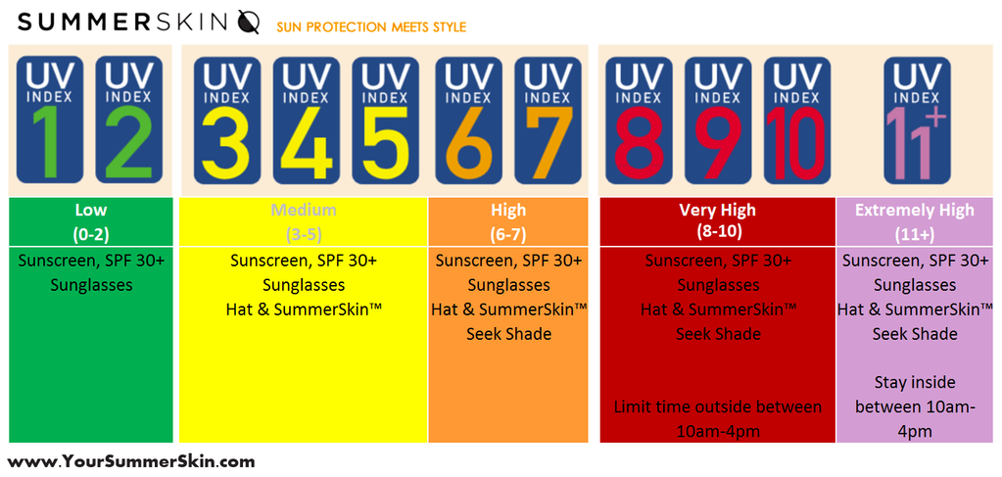
UV Index Scale

Slide 39
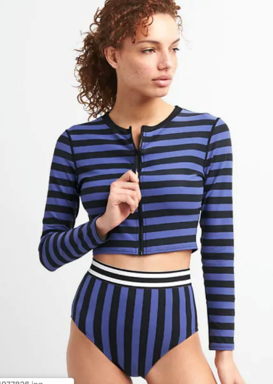
UPF
- UPF = Ultraviolet Protection Factor
- Measures UV protection offered by fabric
- Choose at least UPF 30
- White T-shirt = ~UPF 5
- Darker colors absorb more UV radiation
- Wear clothing that covers a large amount of your skin
Certified UPF 50+

Slide 40
Sunglasses
- UV-A and UV-B radiation can have long- and short-term negative effects on the eyes and vision
- UV → cataracts, macular degeneration, blindness, and melanoma of the eye
- Wear large sunglasses that block 99-100% of UV rays
- Sunglasses also protect the tender skin around your eyes from sun exposure

Slide 41
Hats
Choose wide-brimmed hats
…but, any hat is better than no hat!

Slide 42
SPF
- SPF = Sun Protection Factor (UVB)
- SPF indicates how much UV will be blocked
SPF 15 blocks 93% of UVB
SPF 30 blocks 97% of UVB
SPF 50 blocks 98% of UVB
No sunscreen blocks 100% of UV.
- Need both UVB & UVA protection (broad spectrum)
- Choose > SPF 30 daily
- Choose > SPF 30+ with 80-minute water-resistance and reapply after water activities or sweating
- Use lip balm with > SPF 30

Slide 43
How to select a sunscreen:

Slide 44
How to Apply Sunscreen
- Apply enough sunscreen to cover all exposed skin, but not open wounds
Most adults need about 1 ounce or a golf ball-sized amount to fully cover their body
- Apply 15-30 minutes before going out in the sun
- Don’t forget places like ears, neck and hands
- Apply at least 30 minutes before swimming
- < 1% of people have allergic reactions to some ingredients in certain sunscreens

Slide 45
When to Re-apply?
- Re-apply every two hours
- Re-apply more often after sweating and swimming

Slide 46
Sunscreen and DEET Mosquito Repellant
- Apply sunscreen first, then repellant
- Reapply sunscreen often and don’t reapply repellant (25% DEET should last 5 hours)

Slide 47
Practice Early Detection

Slide 48
Detect Skin Cancer Early
- At least 95% of skin cancer can be cured if detected early!
- Look for:
Changes in spots or moles
Sores that don’t heal
- Report unusual findings to your doctor!

Slide 49
How to Perform a Monthly Skin Check?
Examine your body in the mirror
1. Front and back, then right and left sides
2. Examine elbows, forearms, underarms and palms
3. The backs of the legs and feet; spaces between toes, sole, and nails
4. Examine back of neck and scalp with a hand mirror
5. Finally, check back and buttocks with a hand mirror
*Consult a physician immediately if you have any doubt about a mole or changing spot on your skin*

Slide 50
Promote Sun Smart Behavior
You can influence others and help them to avoid the dangers of over-exposure to the sun.

Slide 51
Summary
- EVERYONE can get skin cancer and should be sun safe
- Avoid sunburns and suntans
- Wear sunscreen & lip balm with SPF 30+
- Wear sun safe clothing, hats and sunglasses
- Limit your time in the sun
- Practice early detection
- Be a good role model for friends

Slide 52
Protect Your Body, It’s The Only One You Get!

Slide 53
References
Merck Manuals
https://www.ncbi.nlm.nih.gov/books/NBK481862/
Cancer Facts and Figures 2019. American Cancer Society. https://www.cancer.org/research/cancer-facts-statistics/all-cancer-facts-figures/cancer-facts-figures-2019.html. Accessed January 14, 2019.
Histology Blog
Skin Cancer Foundation
American Cancer Society - Changes in Genes

